Slide 1
Debugging,
Call Stack and Recursion

Slide 2
Debugging and Debugger

Slide 3
Function Call stack
Call Stack - a data structure - which records function calls

Slide 4
recursion

Slide 5
Recursion
In order to understand recursion you must first understand recursion! © Unknown Philosopher

Slide 6
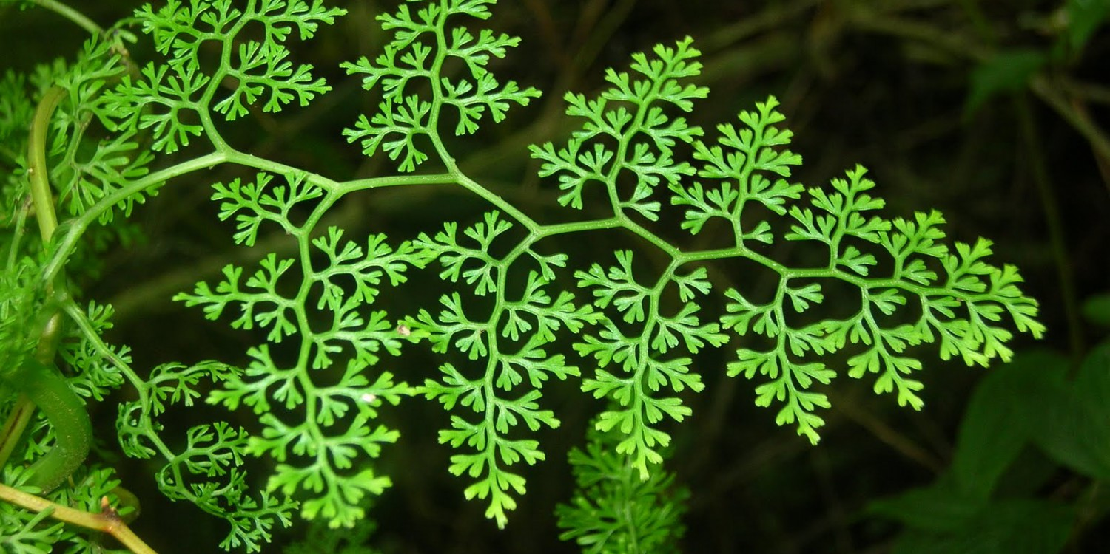

Slide 7
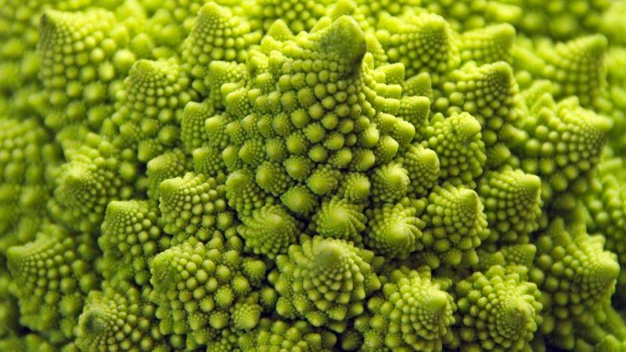

Slide 8
Recursion
It is a technique for creating figures which are defined by "replacement" rules.

Slide 9
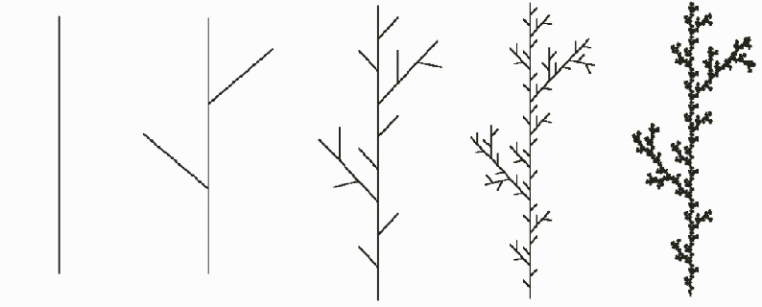

Slide 10
Recursion in programming
Recursive function is a function that calls itself;
By calling itself more than once a function can produce multiple copies of itself.

Slide 11
Recursion in programming
The main thing about Recursion, is that
It sounds simple, but it is complex in practice.
It is perfect for complex problems, as it splits the problem into simple subproblems.

Slide 12
Recursion in programming
Base Case - can be solved directly,it is pretty trivial.
Recursive Case(Inductive - mathematical) - taking a piece of the problem and solving the subproblem recursively, which is identical to the original problem.

Slide 13
Recursion in JS
Leave Event - control statement that allows the function to exit the recursive loop.

Slide 14
EXAMPLE

